Slide 1

Online Rental System
Submitted To- Submitted By-
Ruchi Patel Tanay Pandit
EN16CS301274

Slide 2
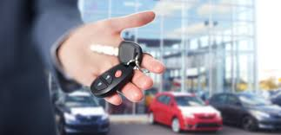
Online Car Rental Application

Slide 3
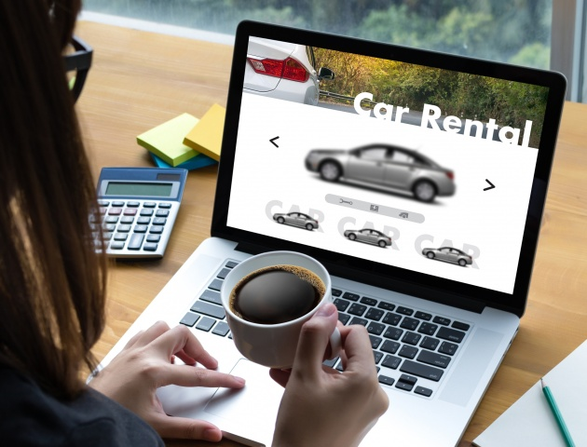
About Project
Online Car Rental system is the most complete web portal for managing car rental business. It is a system designed specifically for medium and small car rentals business. Administrators of this car rental website can add new or change locations, vehicle pictures, rate card. The eCarRental System provides complete functionality of listing and booking car.It is a system in which book a car other city/town/village from another place.As you want.

Slide 4
Problems
The current system has many problems in relation to database management, since it is manual system. The following are problems of the current system (manual system).
Data Security is not assured: -This is due to the manual way of recording the data. It is known that, in manual way, data are being stored by recording it on paper. Therefore, it easily gets damage or misplaced that which lead to data loss.
Searching & data retrieving mechanism of the system takes a lot of time.
Stored Data :- The data store takes more cabinet.
In addition to this it is difficult in order to add some additional requirements to the existing system’s store data (i.e. it is not flexible).
There is the loss of data when storage place gets natural disaster as well as man-made problems (like fire).
Economy:- Since the system currently uses manual system it is not economically sufficient i.e. there is wastage of material &time.
There is one drawback of OLA CABS System. This system can book car/auto/taxi/jeep within a city. One another thing is traveller or normal personal books a vehicle for rent purpose, can book within a city/town/village. They cannot communicate for rent when present in other city. Solution is this project.

Slide 5
Solution
To reduce the paper effort,to save time etc. thing.We introduce a project which is solution of problem. With help of software can achieve a solution.In this solution require a some tools,programming.
The main idea of Rent Car System is using the internet technology with our daily life. Our project helps the rent car office and our main target who are the customers. The employee needs an automated system that helps him and speed up his work with professional way.
Vehicle rental project is a online web portal implemented in asp.net platform using c# programming language. This system is useful for cab organizing companies for efficiently managing and organizing cab service for large number of users through internet. Users can book cab service from any were in the world and take service when they visit that city. There are different services provided based on different level of cab standards.

Slide 6
Requirement Analysis
The operation of the system will be measured in relation to the existing system & the advantages it provides to the user. Be sides this the profit it increases in the company will be identified clearly & set the feasibility of the project. The process of determining the characteristics of the system built in terms of its operational expenditure & maximum output can give :
Technical Feasibility :-
It is planned to implement the system using Asp.Net, MySQL,HTML. It is evident that the necessary soft-ware & hardware are available for development &' implementation of the system. All of the software except window 7 operating system that we use is free download & hence we can confidently conclude that this system is indeed technically feasible.
Organisational Feasibility:-
Since developing this new system will solve most of the car rental company’s problem, the consistent support from the development team & t he training of users will surely deliver a system that will solve the existing business problems and take advantage of various opportunities
.Operational Feasibility:-
It is standard that insures the enter operability without shifting completion &' innovation among user, to the benefit of public both in terms of costs & services quality, the proposed system is acceptable to the users. So that the proposed system operationally feasible.

Slide 7
Tools & Technology
.NET - .NET is a developer platform made up of tools, programming languages, and libraries for building many different types of applications.
The base platform provides components that apply to all different types of apps. Additional frameworks, such as ASP.NET, extend .NET with components for building specific types of apps.
The C#, F#, and Visual Basic programming languages.
C# - C# is a general-purpose, multi-paradigm programming language encompassing strong typing, lexically scoped, imperative, declarative, functional, generic, object-oriented (class-based), and component-oriented programming disciplines.
MySQL - MySQL is an open-source relational database management system (RDBMS).Its name is a combination of "My", the name of co-founder Michael Widenius's daughter,[7] and "SQL", the abbreviation for Structured Query Language.

Slide 8
Module
Admin :
Login
Profile Update
List of Customers
List of Venders
Active/Block Customer
Active/Block Vender
View Booking History Weekly,Monthly,Yearly,by vender
Payment History
Accept Withdraw Request from Vender
View complaints
View reviews
It has three modules :
Admin
Vendor
Customer

Slide 9
Vendor
Add Car
Edit/Delete Car
History of Booking
History of payments
Notification for new Booking (by Email and SMS)
Withdraw Money (Manage By Bank Details Manually)
Update Profile
View Reviews
Customer:
Login
Registration
Profile Update
List of Cars Category Management
List of Cars Available
Book any Car
Payments
History of Booked Cars
Reviews for car vender
Payment History
Post Complaint

Slide 10
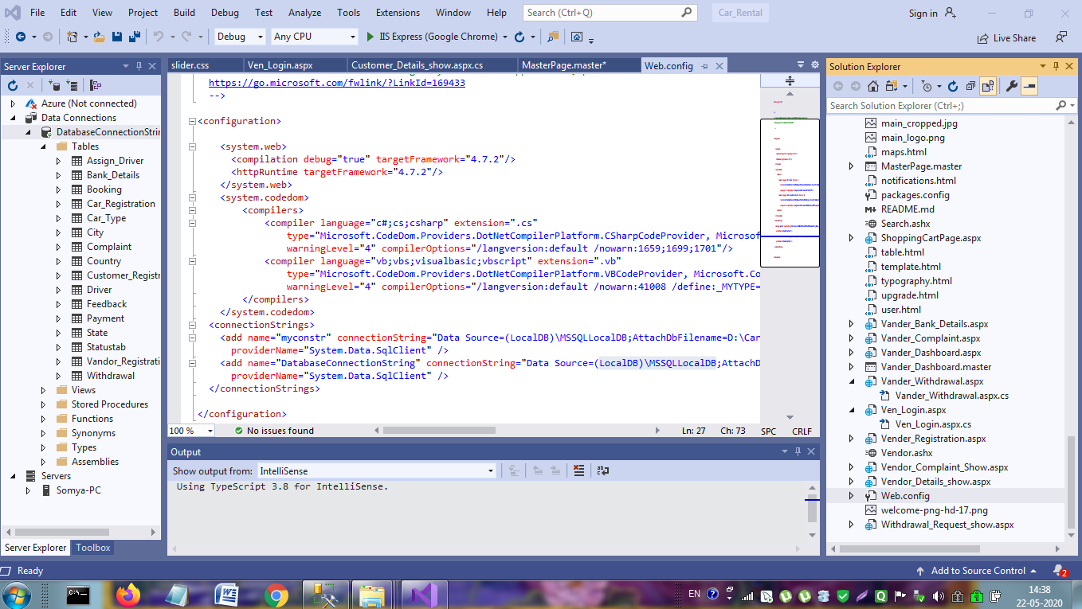

Slide 11
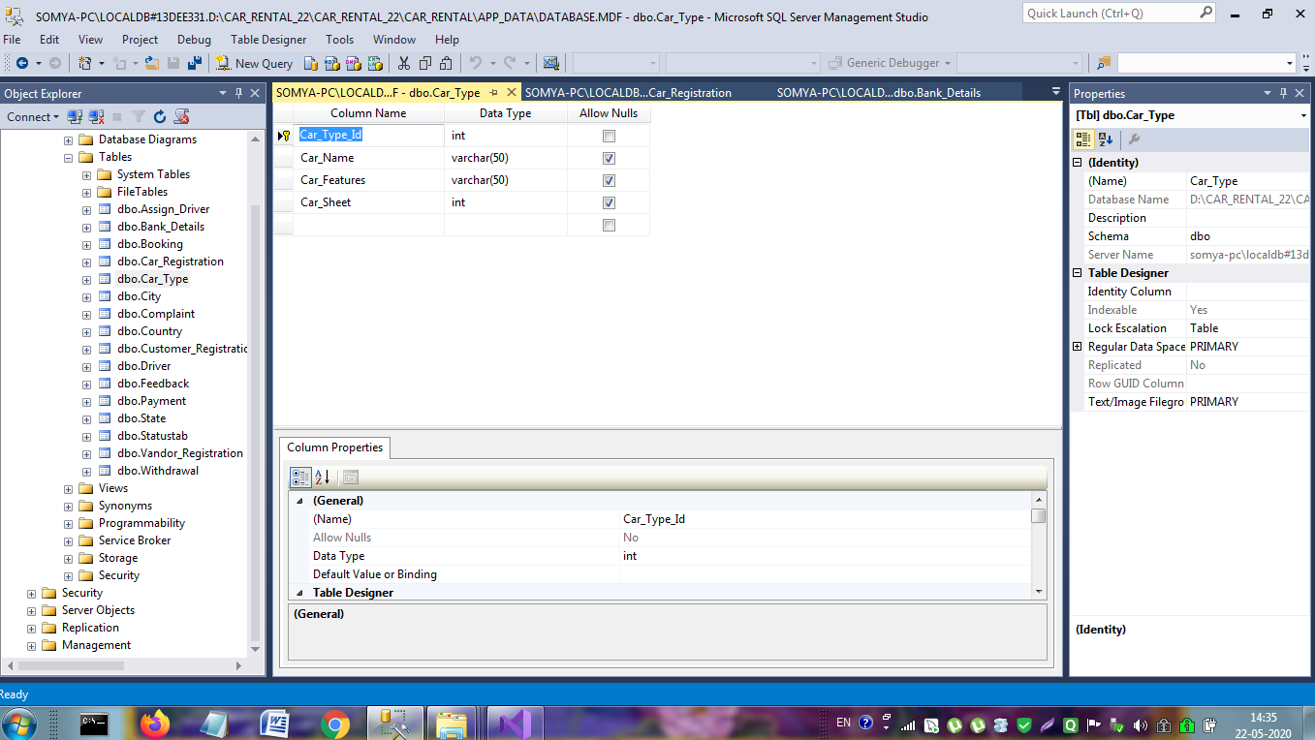

Slide 12
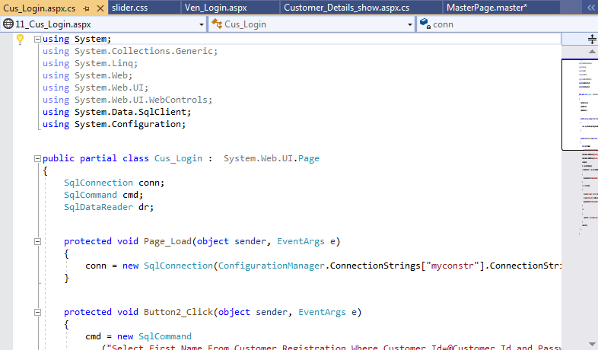

Slide 13
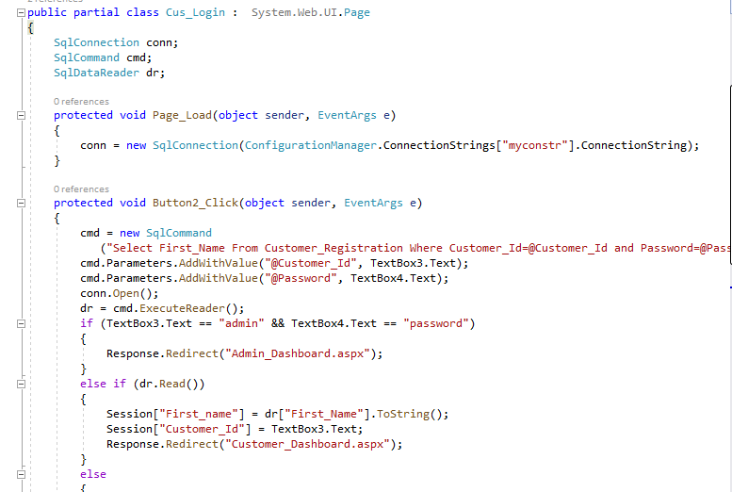

Slide 14
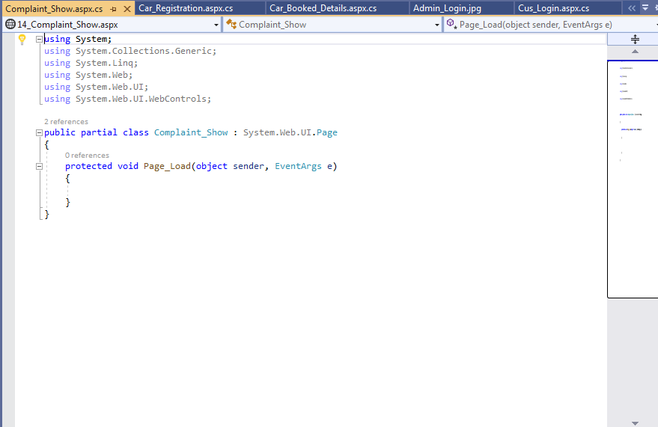

Slide 15
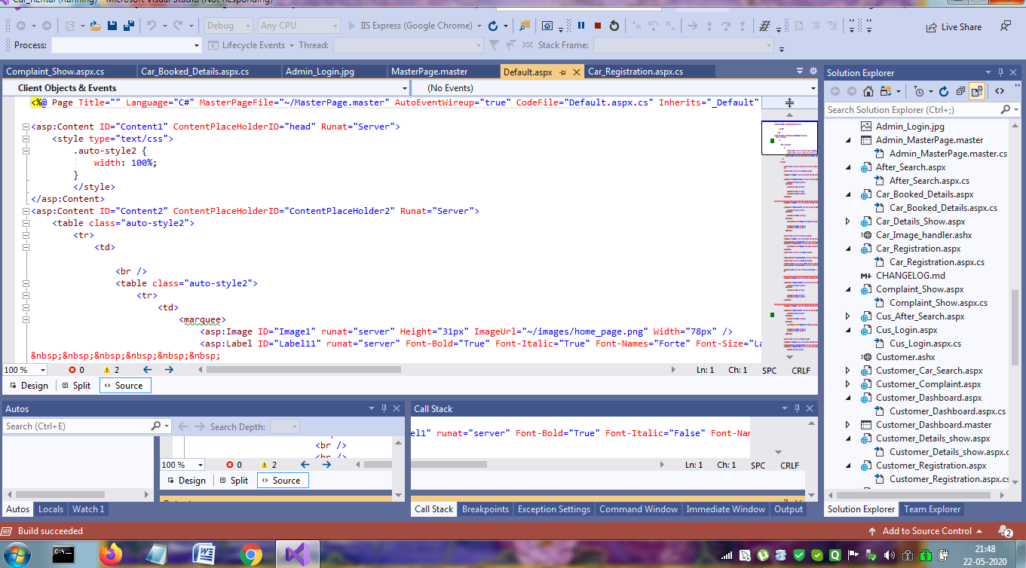

Slide 16
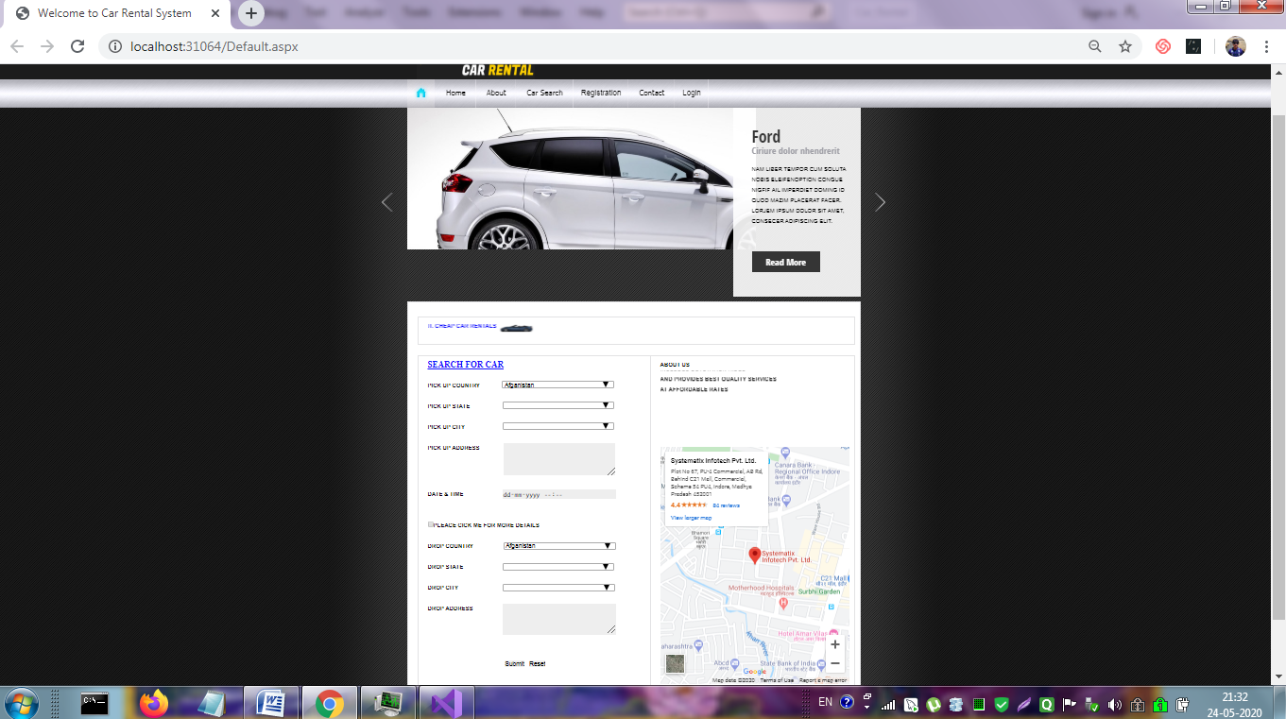

Slide 17
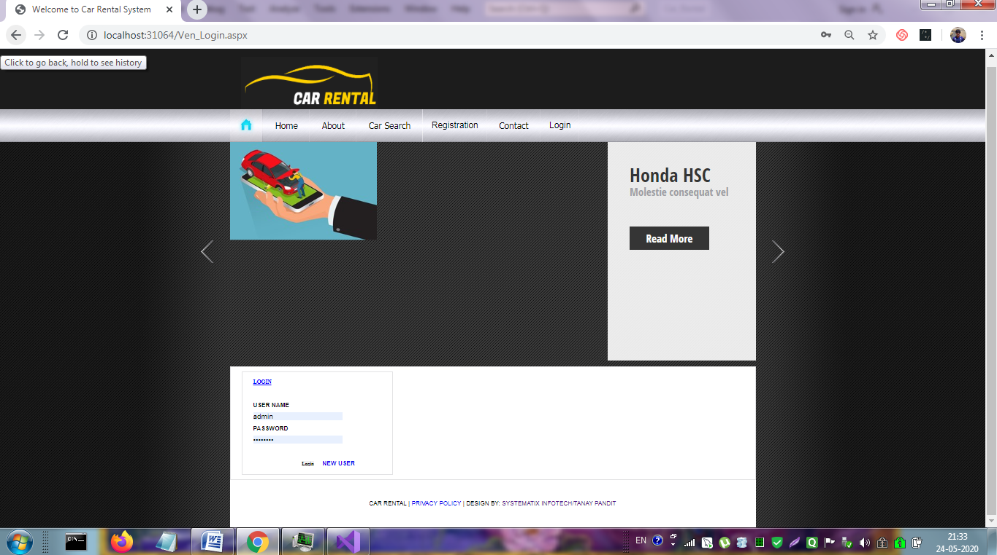

Slide 18
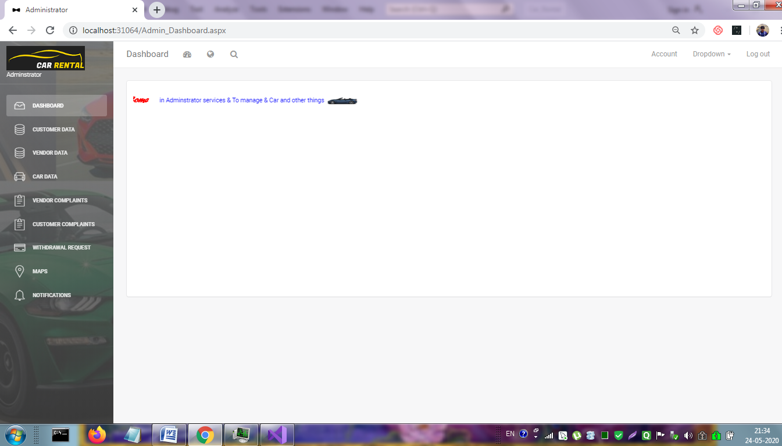

Slide 19
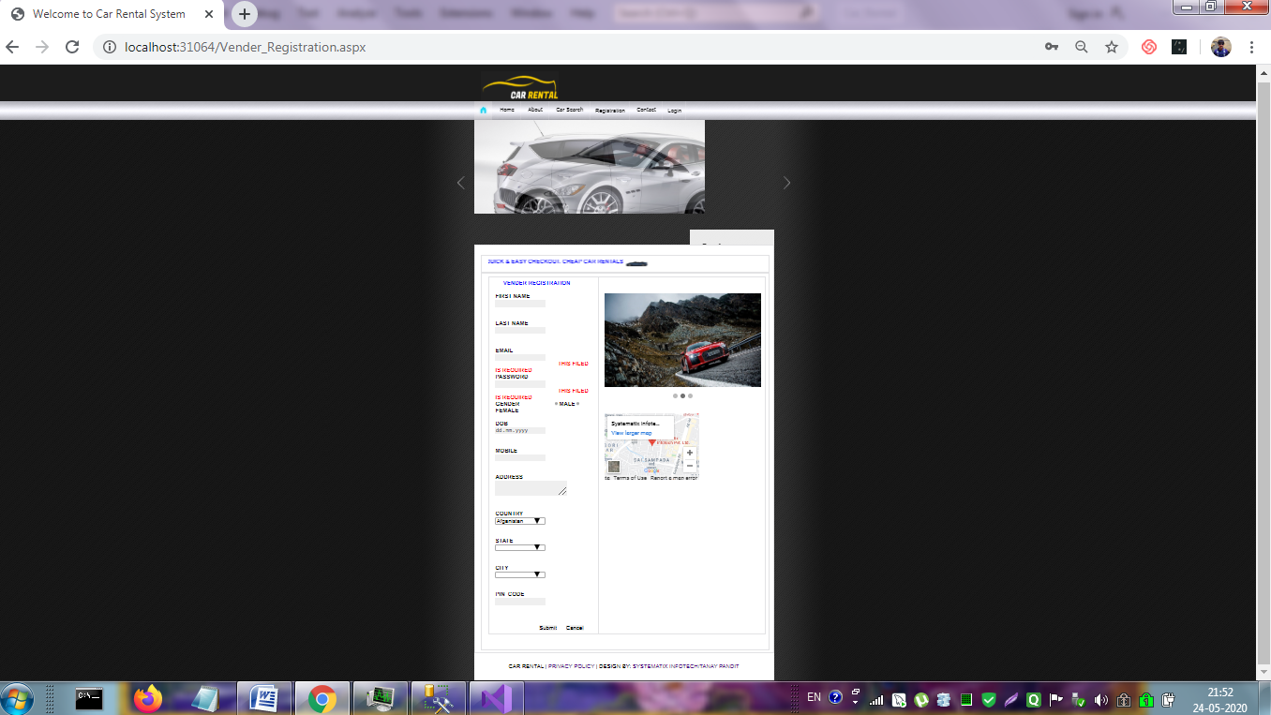

Slide 20
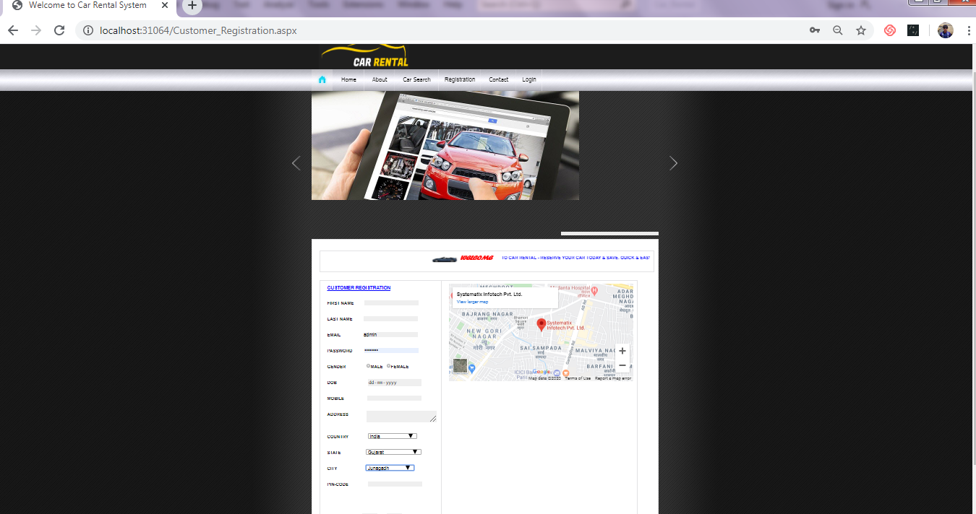

Slide 21
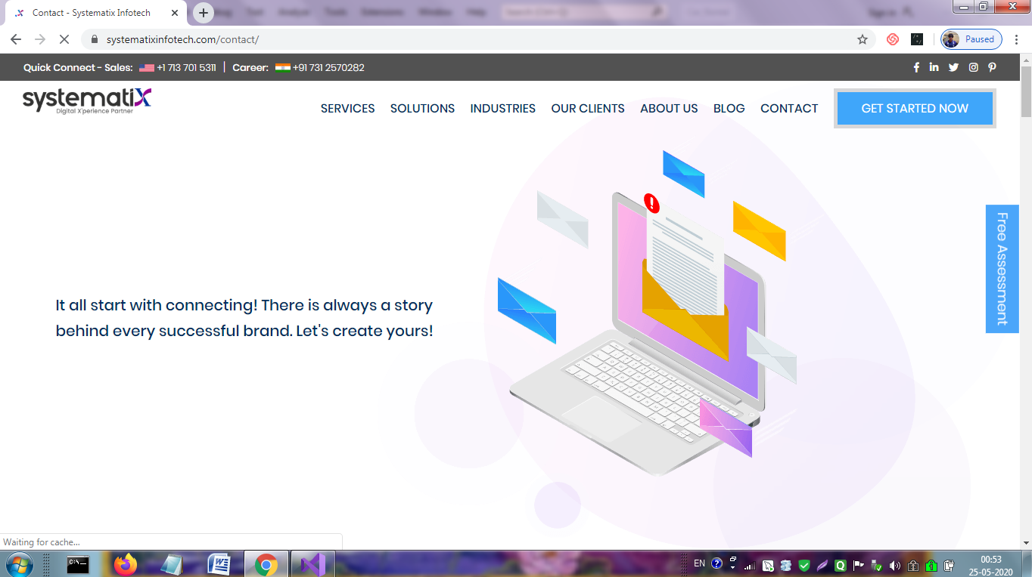

Slide 22
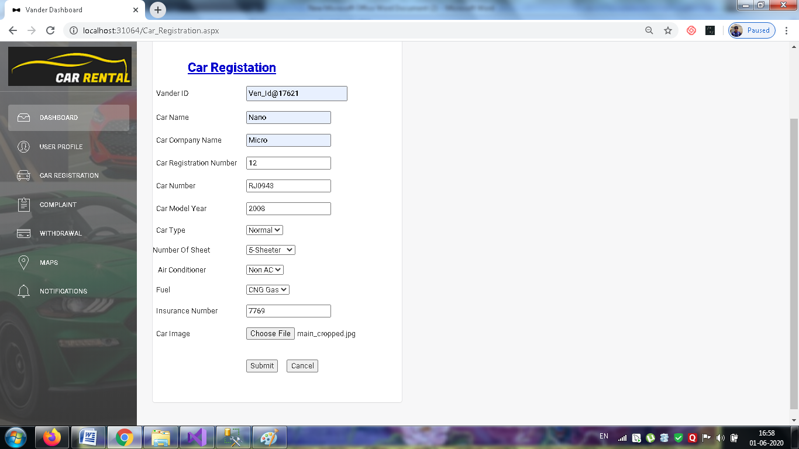

Slide 23
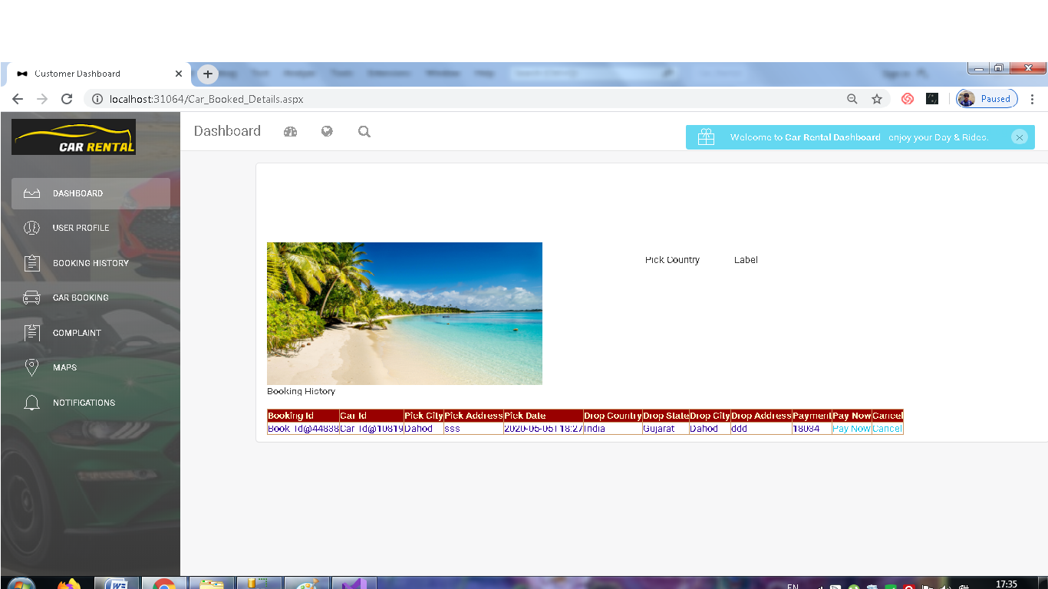

Slide 24
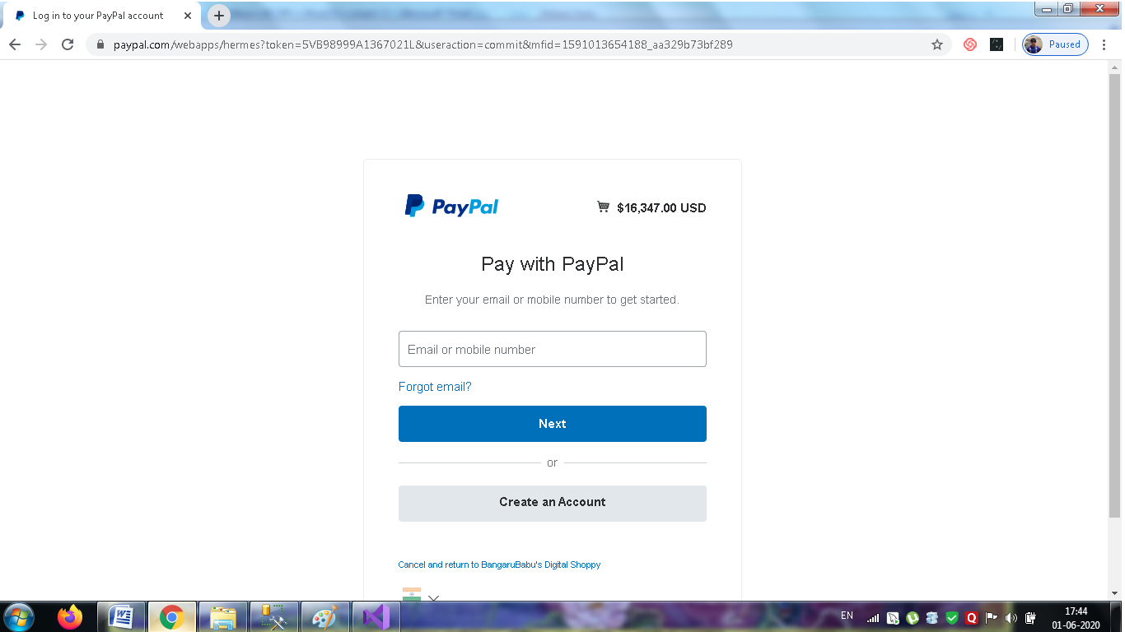

Slide 25
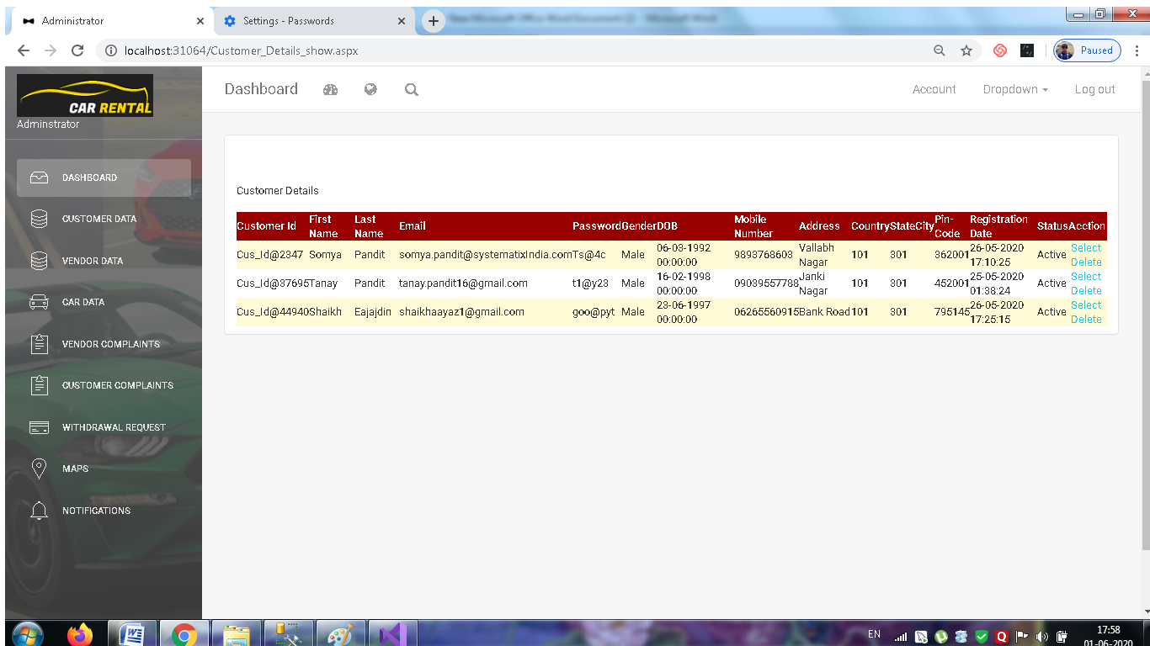

Slide 27
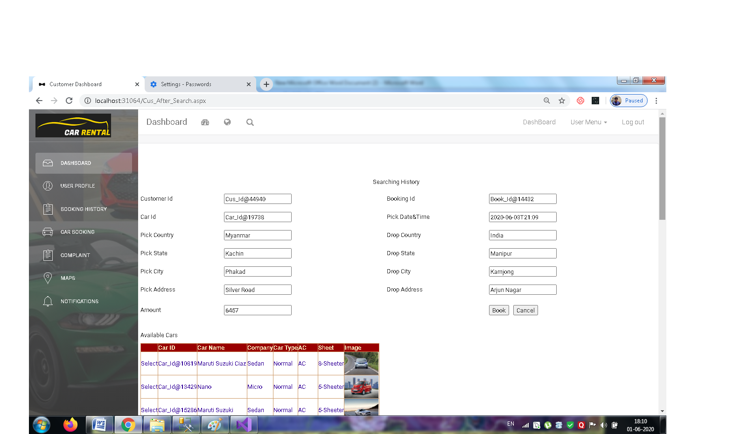

Slide 28
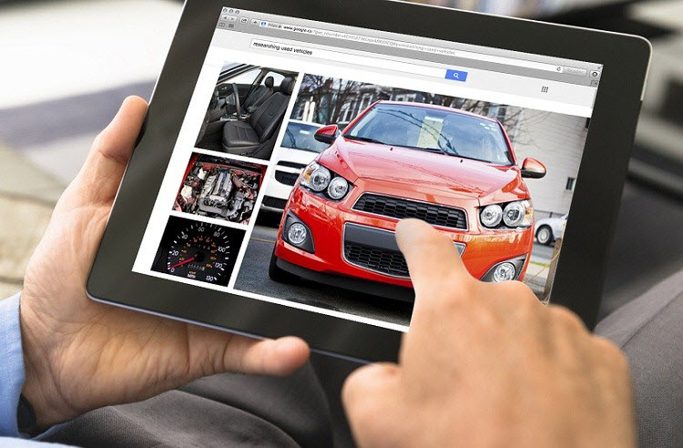
Merit
The car is faster to reach a determined destination.
Can be guided by GPS or different apps to mobilized by the country.
The car is a convenient way, contrary to public transport.
Do not worry about maintaining the car, rent a car because they will be in charged of everything.
The payments are low, since you’re paying for rent, compared to buying a car.

Slide 29
Demerit
Rental companies indicate how mileage may lead; if it exceeds the limit you must pay a penalty defined by the rental agency.
To return the car must be in the same place where it was delivered, otherwise they will be a charge penalty for changing the place of delivery.
Gas is in constant price changes, so can be very costly.
There is traffic congestion on the busiest routes due to the large number of cars.
The car can not leave the country borders.

Slide 30
THANKS

